Slide 1
DES

Slide 2
DES - Confusion and Diffusion Property
Confusion: is an encryption operation where the relationship between key and ciphertext is obscured.
Today, a common element for achieving confusion is substitution, which is found in both DES and AES.
Diffusion: is an encryption operation where the influence of one plaintext symbol is spread over many ciphertext symbols with the goal of hiding statistical properties of the plaintext.
A simple diffusion element is the bit permutation, which is used frequently within DES. AES uses the more advanced Mixcolumn operation.

Slide 3
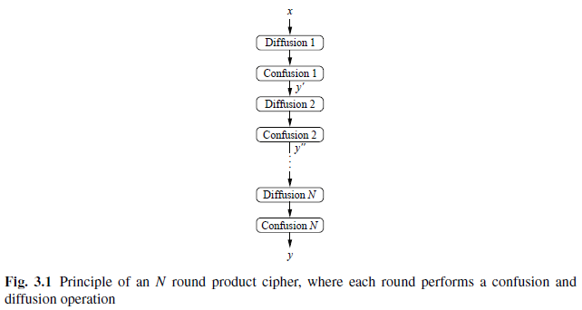
DES - Confusion and Diffusion Property
The idea of concatenating several encryption operation was also proposed by Shannon. Such ciphers are known as product ciphers. All of today’s block ciphers are product ciphers as they consist of rounds which are applied repeatedly to the data (Fig. 3.1).

Slide 4
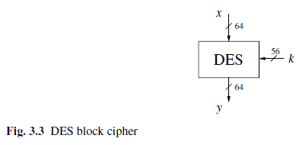
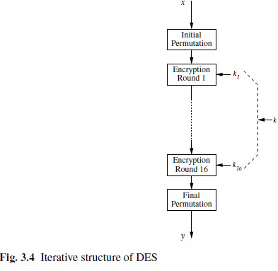
Overview of DES
DES is a cipher which encrypts blocks of length of 64 bits with a key of size of 56 bits (Fig. 3.3).
DES is a symmetric cipher, i.e., the same same key is used for encryption and decryption. DES is, like virtually all modern block ciphers, an iterative algorithm.
For each block of plaintext, encryption is handled in 16 rounds which all perform the identical operation.
Figure 3.4 shows the round structure of DES. In every round a different subkey is used and all subkeys ki are derived from the main key k.

Slide 5
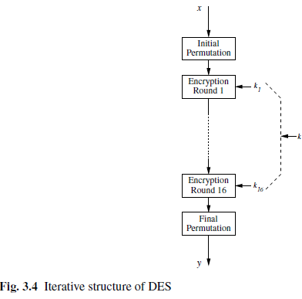
Overview of DES
Let’s now have a more detailed view on the internals of DES, as shown in Fig. 3.5.
The structure in the figure is called a Feistel network. It can lead to very strong ciphers if carefully designed.
Feistel networks are used in many, but certainly not in all, modern block ciphers. (In fact, AES is not a Feistel cipher.)
In addition to its potential cryptographic strength, one advantage of Feistel networks is that encryption and decryption are almost the same operation.

Slide 6
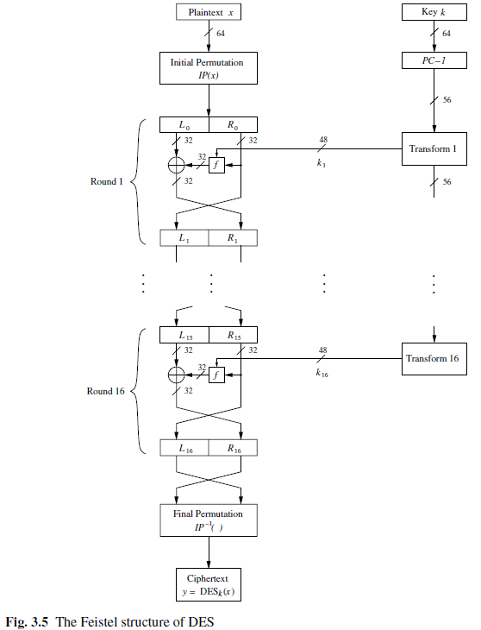
Overview of DES

Slide 7
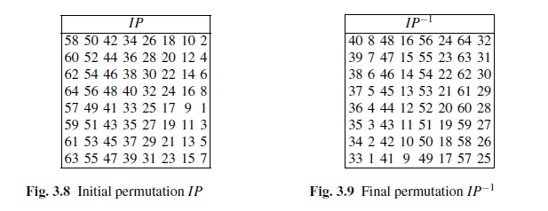
Internal Structure of DES
The details of the transformation IP are given in Fig. 3.8. This table, like all other tables in this chapter, should be read from left to right, top to bottom. The table indicates that input bit 58 is mapped to output position 1, input bit 50 is mapped to the second output position, and so forth.
The final permutation IP−1 performs the inverse operation of IP as shown in Fig. 3.9.

Slide 8
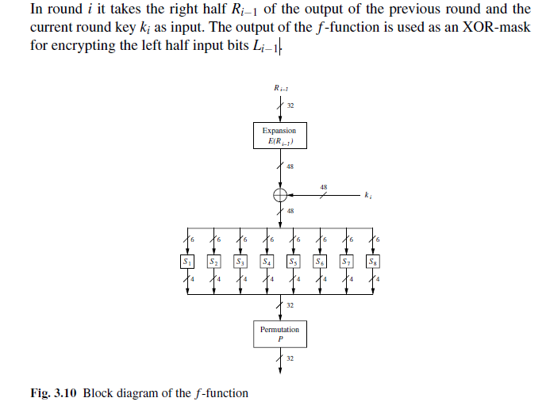
The f Function

Slide 9
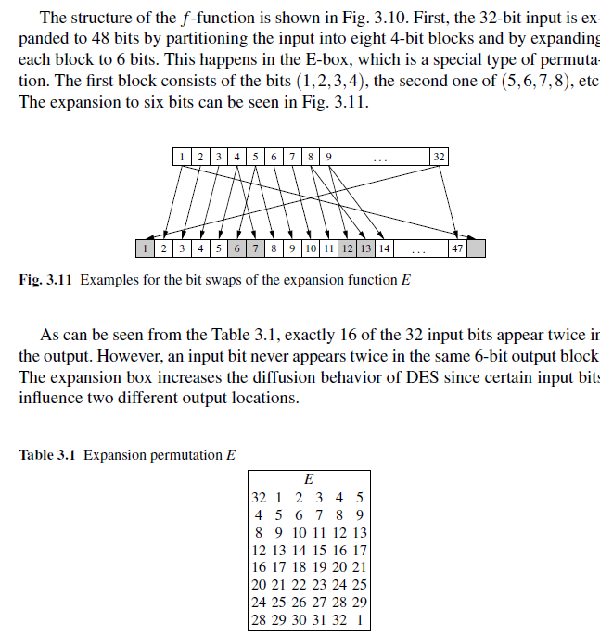
The f Function

Slide 10
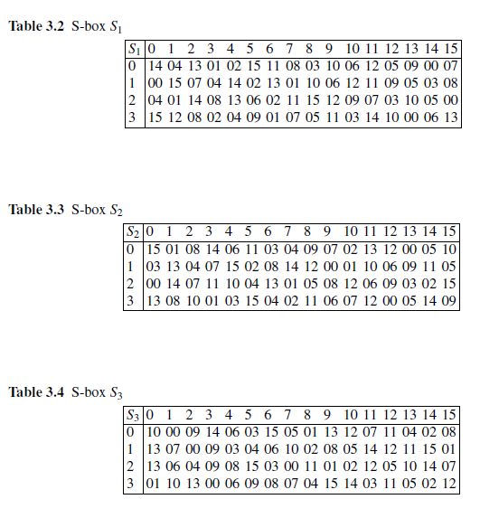
The f Function
Next, the 48-bit result of the expansion is XORed with the round key ki, and the eight 6-bit blocks are fed into eight different substition boxes, which are often referred to as S-boxes. Each S-box is a lookup table that maps a 6-bit input to a 4-bit output.

Slide 11
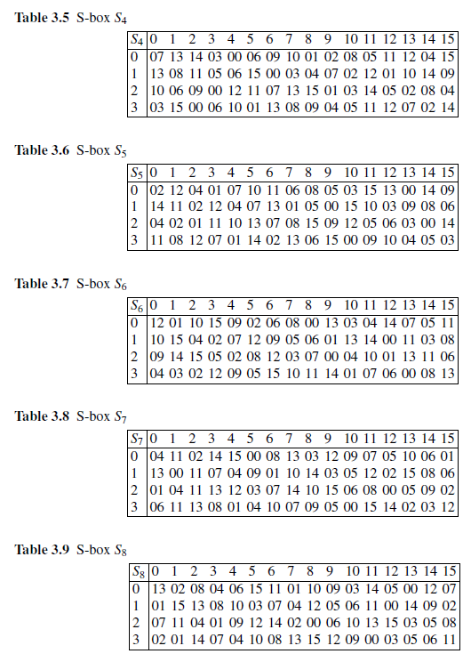

Slide 12
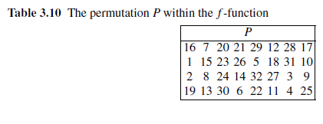
The f Function
Finally, the 32-bit output is permuted bitwise according to the P permutation, which is given in Table 3.10.
Unlike the initial permutation IP and its inverse IP−1, the permutation P introduces diffusion because the four output bits of each S-box are permuted in such a way that they affect several different S-boxes in the following round.
The diffusion caused by the expansion, S-boxes and the permutation P guarantees that every bit at the end of the fifth round is a function of every plaintext bit and every key bit. This behavior is known as the avalanche effect.

Slide 13
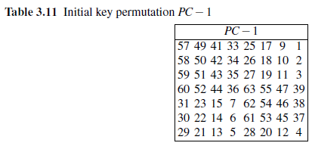
Key Schedule
The key schedule derives 16 round keys ki, each consisting of 48 bits, from the original 56-bit key.

Slide 14
Key Schedule
The resulting 56-bit key is split into two halves C0 and D0.
The two 28-bit halves are cyclically shifted, i.e., rotated, left by one or two bit positions depending on the round i according to the following rules:
In rounds i = 1,2,9, 16, the two halves are rotated left by one bit.
In the other rounds, the two halves are rotated left by two bits.

Slide 15
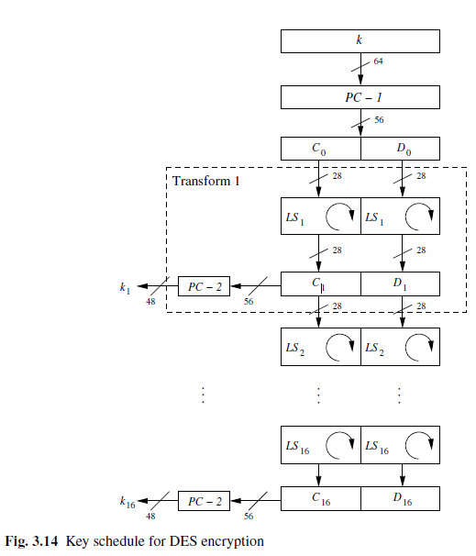
Key Schedule

Slide 16
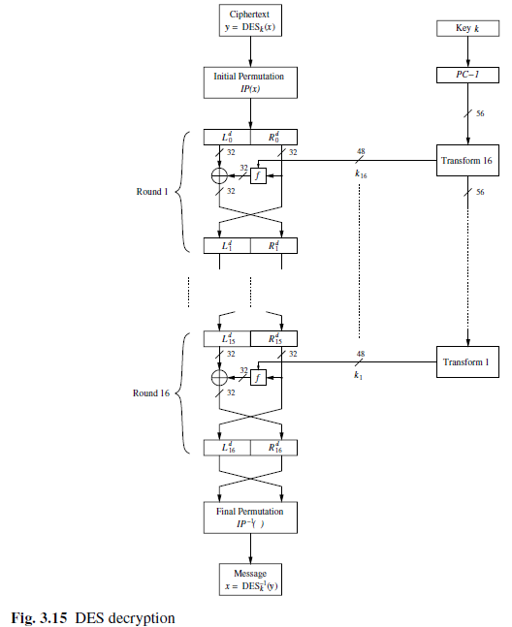
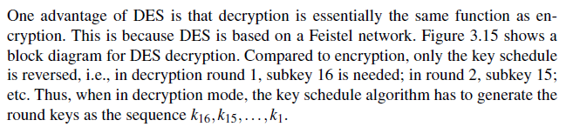
Decryption

Slide 17
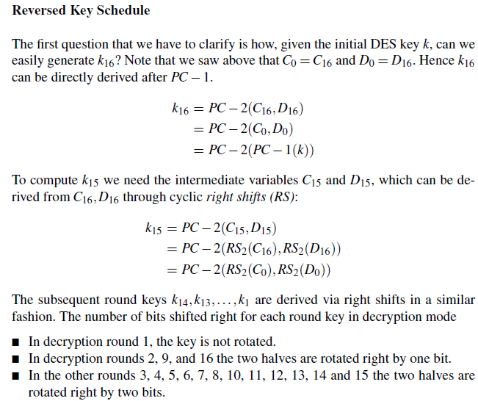
Decryption - Reverse Key Schedule

Slide 18
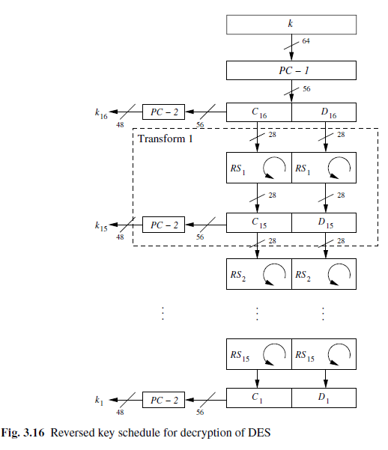
Decryption -Reverse Key Schedule

Slide 19
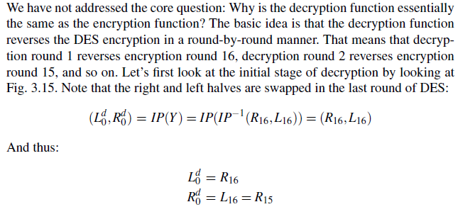
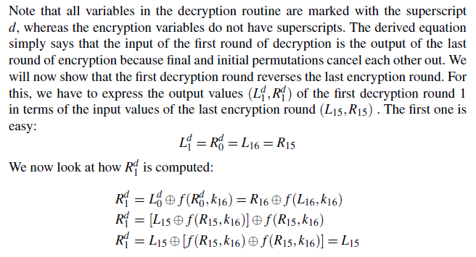
Decryption in Fiestal Networks

Slide 20
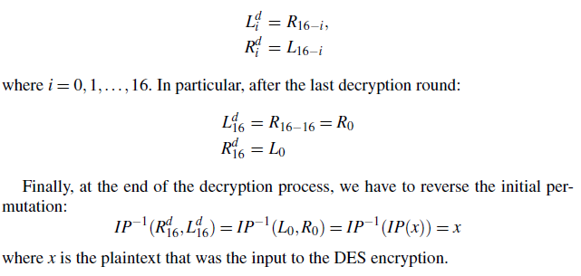
Decryption in Fiestal Networks
The crucial step is shown in the last equation above: An identical output of the f -function is XORed twice to L15. These operations cancel each other out, so that Rd1 =L15.
Hence, after the first decryption round, we in fact have computed the same values we had before the last encryption round. Thus, the first decryption round reverses the last encryption round. This is an iterative process which continues in the next 15 decryption rounds and that can be expressed as:

